Slide 1
REVIEW
(Answer the following on the corner of your notes page)
What does the prefix kilo- mean? centi-?
How many mm are in 7cm?
What is the sum (in m) of 15 m + 1000 mm + 400 cm?
What is the area of the following rectangle in cm²?
7 cm
30 mm

Slide 2
Quiz FRIDAY on Word Parts List #1
ab– means “away from”
Sample Question:
The ___-ductor muscles pull the legs and arms away from the body.

Slide 3
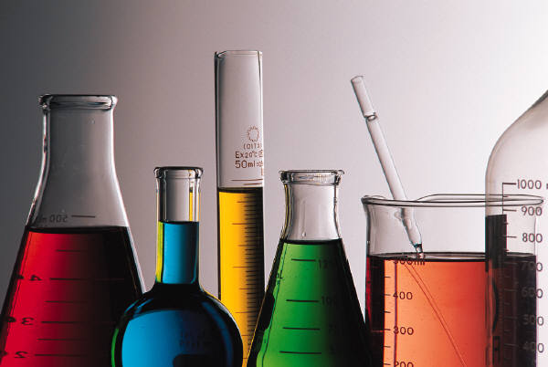
EQ—How do I solve problems in Science?
Scientific Inquiry

Slide 4
The Characteristics of Living Things:
1. All living things must have cells.
Organisms are either multi-cellular or unicellular.
2. All organisms must be able to reproduce.
They may do this asexually or sexually.
3. All organisms have a genetic code:
DNA or RNA

Slide 5
The Characteristics of Living Things:
All organisms must grow and develop.
Organisms must have a metabolism:
  Obtain and use materials for energy.
Organisms must respond to the environment.
Organisms must maintain homeostasis.
  This means an organism maintains a constant internal environment.

Slide 6
The Characteristics of Living Things:
8. All organisms must change or evolve over a period of time. (We will discuss this more later – populations evolve NOT individuals.)

Slide 7
Inferences vs. Observations
An inference is a conclusion based on prior knowledge (interpretation).
An observation is actually measured or detected with the senses.

Slide 8
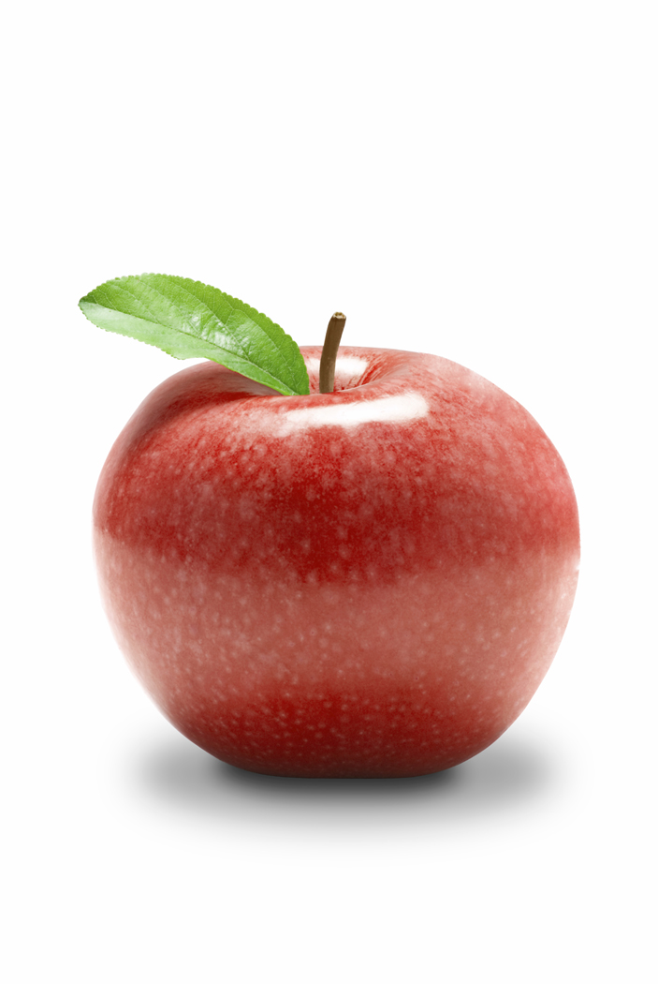
Inferences vs. Observations
Imagine you are holding this apple…
The skin is red.
The apple is edible.
There are seeds inside.
It can make you healthy.
It feels smooth.

Slide 9
During an experiment, you need to make and record observations to gather data.
There are 2 types of observations:
1. Qualitative: color, texture, smell, sounds, etc. (subjective)
2. Quantitative: numbers/measurement (objective)

Slide 10
The Scientific Method is used by scientists to solve problems in science:
Problem/Observation. What do you want to know? What do you want to find out? This is typically in the form of a question.
Hypothesis. This is a possible solution to your problem. It is a testable statement or a possible explanation for a set of observations. (If, then format usually).
Experimental Design: An experiment is designed to test your hypothesis. There are several parts to good experimental design…

Slide 11
  Control: a part of the experiment that is not being tested and is used for comparison.
  Variable: Any part of the experiment that can vary or change.
      Independent variable: The part of the experiment that is manipulated or changed by the scientists or person doing the experiment (the one factor different from the control set-up) aka - manipulative variable
      Dependent Variable: The part of the experiment that is affected by the independent variable. This is usually the outcome you are looking for (compare the dependent variable in both the experimental set-up and the control set-up) aka – responding variable

Slide 12
4. Results (data analysis): The part of the process in which data is collected and organized into a graph, table, etc.
5. Conclusion: The part of the process in which you determine whether your hypothesis was supported or not supported and WHY!! Discuss what could have gone wrong and what improvements you could make to the experiment. Analyze your results & design; publish & have others (peers) review.

Slide 13
Experimental Design
Control Set-up | Experimental Set-up
All factors are kept “normal” Does not have the independent variable you are testing. Used as a comparison to the experimental set-up | All factors are kept the same as the control set-up EXCEPT for the independent variable you are testing. Compare the dependent variable from the experimental set-up to the dependent variable of the control set-up. Changes in dependent variable in exp. setup should be due to the independent variable

Slide 14
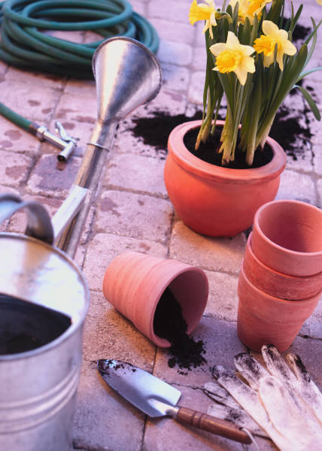
Example:
Problem: Do plants grow faster with sugar water or plain water?
Hypothesis: ???
Experimental Design:
Control Set-up | Experimental Set-up
Plant watered with water ONLY All other factors the same as the experimental set-up Sunlight Soil Pot type/size Fertilizer Amount of water Etc. | Plant watered with sugar water ONLY All other factors the same as the control set-up Sunlight Soil Pot type/size Fertilizer Amount of sugar water Etc.

Slide 15

Example:
Homer Simpson notices that his shower is covered in green slime.
His friend Barney tells him that coconut juice will get rid of the green slime.
Homer decides to check this out by spraying half of the shower with water and half with coconut juice.
After 3 days of “treatment” there is no change in the appearance of green slime on either side of the shower.

Slide 16
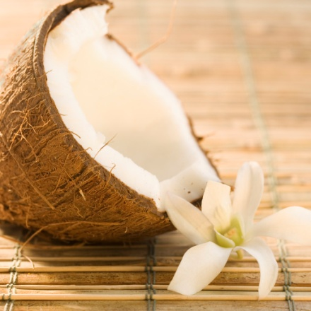
What is the control group?
The water
What is the independent variable?
 The coconut juice
What is the dependent variable?
 The amount of slime on the shower

